Slide 1
Student Well-Being
Our Services
Updated Summer 2024
Notes:
Please do not change location of text boxes, size of text, color of text, shapes, etc
Stephanie and Derek

Slide 2
Student Well-Being
Student Well-Being provides counseling services, health promotion initiatives, and prevention programs to empower the S&T community to thrive and enhance personal, academic, and professional success.
Notes:
As a note when covering all the different resources in this section, you can find contact information for each different resource and department at the bottom of the slide.
Stephanie

Slide 3
Student Well-Being
Our Services
We provide the following services:
Counseling
Care Management
Wellness Consultations
Wellness Programming
Bystander Intervention
Joe’s PEERS
Miner Support Network
ProjectConnect
Miner Oasis
Canvas Course
wellbeing.mst.edu | wellbeing@mst.edu | 204 Norwood Hall | (573).341.4211
Notes:
Stephanie

Slide 4
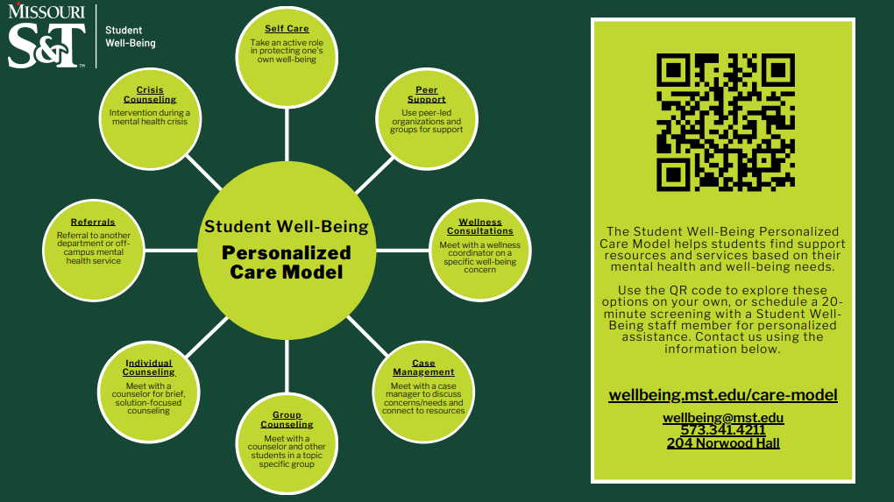
Notes:
Stephanie
When first meeting with our office you will complete a screening with a staff member. During the screening, the staff member will ask you a short list of questions. They will then walk you through the Personalized Care Model, a visual way to help determine what support type is best for you based on your individual needs. You can schedule a screening on our website (wellbeing.mst.edu) or call 573.341.4211
Personalized care model- the student well-being personalized care model acts as a visual representation of available support services to help students determine what is available to support their unique mental health and well-being needs. While this model features services and resources outside of our department, it is a good jumping off point to discuss what is available to students when seeking support.
All services and resources provided by Student Well-Being are free to all enrolled students.

Slide 5
Department Services
Counseling
Our counseling services are free, confidential, provided by licensed counselors, and are available for all students.
Individual Counseling
Group Counseling
Crisis Counseling
Community Referrals and Resource Referrals
After Hours Resources
Notes:
Stephanie
Note that counseling services are provided by non-mandated reporters and adheres to HIPAA regulations (similar to student health or other healthcare providers)
We have 8 counselors on staff and all Student Well-Being counselors are at least Masters level educated and are fully licensed as either a Licensed Professional Counselor (LPC), Licensed Social Worker (LSW), Provisional Licensed Professional Counselor (PLPC), or Licensed Psychologist (PhD) in the state of Missouri. The only exception to this is if there is an on-staff Practicum Student, who is Bachelors level educated and is working on completing their Masters degree. Counseling staff follow all state and federal counseling/ therapeutic laws and regulations.
Are there session limits? No. We offer brief, solution focused counseling and the number of sessions is determined by the counselor (on average, students engage in 3-4 sessions). Participation in groups of any amount and frequency is not limited.
We offer over ten group counseling on a variety of topics.

Slide 6
Department Services
Wellness Consultations
Wellness consultations are free coaching sessions provided by wellness coordinators in a short-term format.
Nutrition
Alcohol Use
Cannabis/Marijuana Use
Bystander Intervention
Grit and Resilience Workshops
LGBTQ+
Self Regulation
Nicotine Cessation
Wellness Coaching
General Wellness
Notes:
Derek
Read from slide
*Note that wellness consultations are provided by mandated reporters

Slide 7
Department Services
Case Management
Our Case Managers work to assist students by addressing immediate needs, connecting to appropriate resources, and working to help students navigate barriers to their well-being and success. A successful strategy may include:
Various resources
Continuity of care services
Provide accountability through supportive follow-up
Notes:
Derek
Read from slide
*Note that care managers are provided by mandated reporters

Slide 8
Department Services
Wellness Presentations and Programming
Student Well-Being offers presentations, trainings, and outreach events for groups, departments, organizations, and general campus community members. Some programming offered:
Bystander Intervention
Nutrition/Healthy Eating
Healthy Coping Skills
Resource Awareness
Stress and Time Management
Resilience and Mindfulness
Motivation
Self Care
Notes:
Derek
Student Well-Being provides presentations, trainings, and workshops to organizations, classes, and other groups that request them. Requests can also be made for department presence, such as for a discussion panel, event, meeting, etc. A request for department presence does not have to be directly related to a pre-made presentation.
All requests must be made at least two weeks in advance. Special, tailor-made requests must be done one month in advance.
Depending on the presentation requested, we may schedule a consultation with you to tailor the presentation to your group's goals.

Slide 9
Department Services
Bystander Intervention
Our STEP UP! Bystander Intervention Program helps students, faculty, and staff recognize problematic events and increases their motivation, skills, and confidence when responding to problems or concerns. Current trainings offered are STEP UP! for:
Mental Well-Being
Diversity and Inclusion
Sexualized Violence Prevention
Safer Drinking
Notes:
Derek
STEP UP! empowers the campus community to foster a culture of awareness, intervention, and inclusion in all our interactions in person, on social media, and virtually.

Slide 10
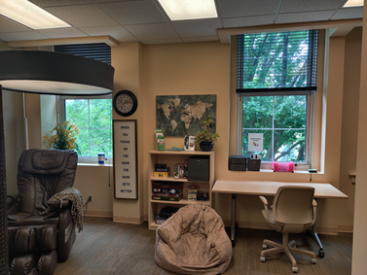
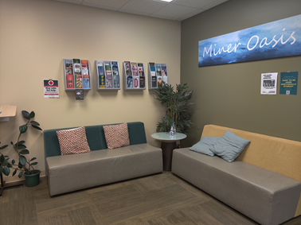
Department Services
Student Well-Being (continued): Miner Oasis
wellbeing.mst.edu | wellbeing@mst.edu | 201 Norwood Hall | (573).341.4211
Notes:
Derek
The Miner Oasis is simply a place to relax.
We have coloring books, customizable essential oils, coffee and tea, yoga mats, and a massage chair to help you de-stress and be your best self!
The Miner Oasis is open Monday - Friday, 8am - 5pm, in 201 Norwood Hall

Slide 11
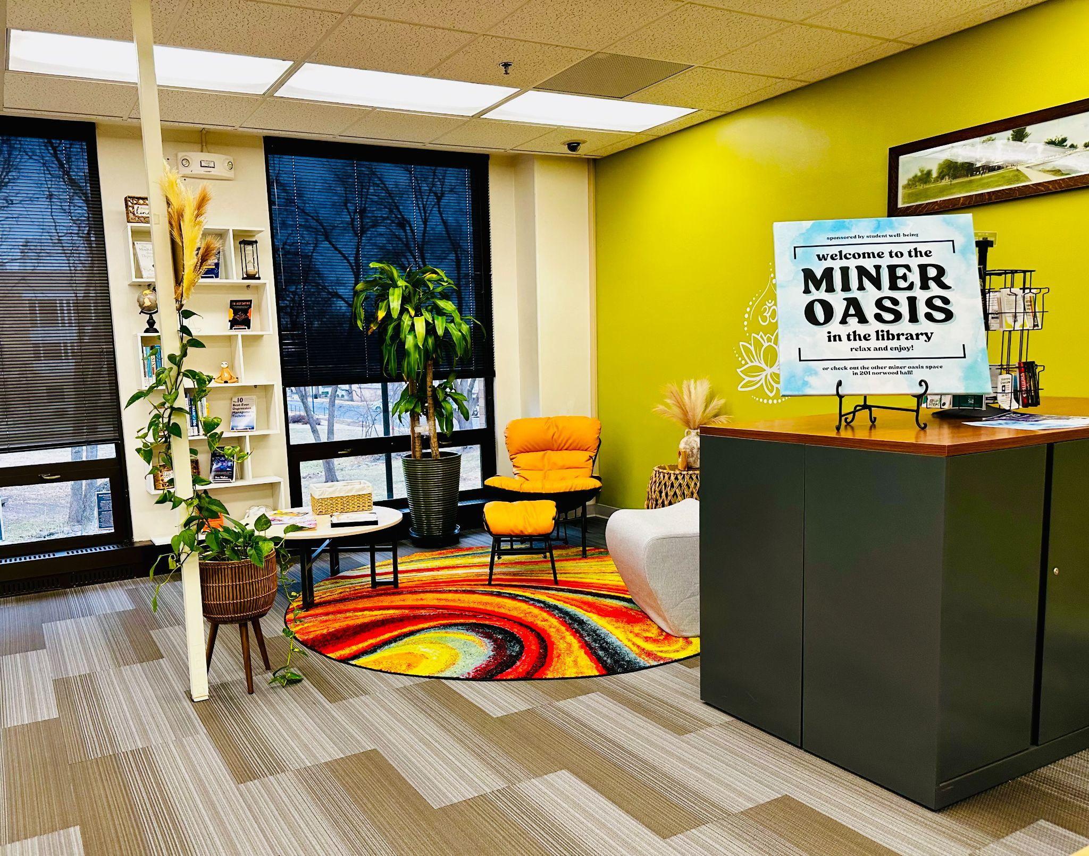
Department Services
Miner Oasis in the Curtis Laws Wilson Library
Notes:
Derek
The Miner Oasis is simply a place to relax.
We have coloring books, customizable essential oils, coffee and tea, yoga mats, and a massage chair to help you de-stress and be your best self!
The Miner Oasis is open Monday - Friday, 8am - 5pm, in 201 Norwood Hall

Slide 12
Department-Led Committees
Prevention Coalition
Prevention Coalition is a network of campus and community partners who utilize S&T specific data to guide wellness initiatives, encouraging positive choices among students and reduce the impact of high-risk behavior associated with alcohol and other drugs. We collaborate closely with Partners in Prevention (PIP) and other Missouri universities to guide and improve Student Well-Being programming.

Slide 13
Department-Led Committees
Health and Well-Being Committee
The Health and Well-Being Committee is designed to review our current systems, programs, and policies to build upon existing and create new mental well-being, substance abuse, and suicide prevention efforts. As part of the process, each school establishes an interdisciplinary, campus-wide team to assess, support, and implement improvements.

Slide 14
Student-Led Services
Joe’s PEERS
Joe's PEERS (JPs) is a student leadership organization that provides education, encouragement, and resources to students and campus community members through events, programming, and more.
Meetings are held every Monday at 12pm throughout the semester and students can join at any point.
Notes:
Stephanie
JOE’S PEERS is a student leadership organization that promotes health and wellness by providing education,encouragement, and resources to Missouri S&T students.
Joe’s PEERS members will develop experience in public speaking, interpersonal communication, self-management, teamwork, and act as resource persons to the campus community.
It is open to both undergraduate and graduate students.

Slide 15
Student-Led Services
Miner Support Network
The Miner Support Network is a campus organization that works to de-stigmatize mental health through confidential, weekly, peer-facilitated support groups, while holistically working to create an inclusive community dedicated to empathy, trust, and relationship building through network-wide stress-busting events.
Students can join at any point in the semester.
Notes:
Stephanie
The Miner Support Network is a student-led campus organization that works to de-stigmatize mental health through confidential, weekly, peer-facilitated groups while holistically working to create an inclusive community dedicated to empathy, trust, and relationship building through network-wide stress-busting events.

Slide 16
Student-Led Services
ProjectConnect
ProjectConnect is a fun, 6-session peer-led program aimed at helping students build social connections and community on campus. Students meet in groups of 4-6 over the course of six 1-hour sessions, and engage in a series of thought-provoking questions and fun activities, ending with a group event.
Sign ups are at the beginning of each semester.
Notes:
Stephanie

Slide 17
Online Resources
Miner Well-Being Certification Program
The Miner Well-Being Certification Program is a series of activities focused on different areas of well-being, encouraging a more holistic and well-rounded look at wellness. Participants who complete the program receive a certificate and letter of recommendation signed by the Director of Student Well-Being.

Slide 18
Online Resources
Health and Well-Being Canvas Course
This non-credit Canvas course houses various trainings, screenings, lessons, and more to learn to support your own and others well-being. Students can enroll at any time for free. It is listed as "ROLLA- Health and Well-Being" on Canvas.

Slide 19
Online Resources
Health and Well-Being Resource Directory
Our website features the Health and Well-Being Resource Directory, a new resource that has on-campus, off-campus, and online resources available to you, categorized by topic area, such as:
Mental health
Alcohol/Substance misuse
Academic
Disordered eating
Financial concerns
Career
Disability/accessibility support
General/physical health
LGBTQ+
Sexual Health
And many more!
Notes:
Stephanie
We also have a group specific resource flyer for graduate students and resource flyers in multiple languages, such as Spanish, Hindi, Chinese, and Arabic.

Slide 20
Online Resources
Available for anyone, not just S&T students!
Featured on our website are resources you can use on your own time to increase your well-being, knowledge of resources on campus, and more. Some available are:
Self screenings and assessments
Monthly Wellness Connection newsletters
Self-Help apps and websites
https://wellbeing.mst.edu/self-education/screeningsandtrainings/
https://wellbeing.mst.edu/self-education/appsandwebsites/
Notes:
Stephanie

Slide 21
Resources Available 24/7
Always call 911 first in an emergency
National Suicide and Crisis Prevention Lifeline
988
Crisis Text Line
Text “HOME” to 741741
Compass Health Hotline
(833)356-2427
Phelps Health
(573)458-8899
Notes:
Stephanie

Slide 22
Defining Mindfulness
What is it and how can it help
Notes:
Derek
Mindfulness is a tool that can be used to address these types of thoughts. When our minds are filled with thoughts of not being good enough, mindfulness allows our brain a break and allows us to bring our emotions back down to neutral. Its like a little break. We are essentially taking ourselves out of our head and putting ourselves in the moment.

Slide 23
Defining Mindfulness
What is it?
Maintaining awareness of and understanding our thoughts, feelings, bodily sensations, and surrounding environment
Paying attention to our thoughts and feelings without judgement
Being present in the moment and allowing time to reflect and intentionally relax
Notes:
Derek
Let’s start by defining mindfulness. So what is mindfulness.
Mindfulness is basically bringing ourselves back to awareness in the body. We are looking at our thoughts and sensations (using our 5 senses) and being aware of them without judgement. We do so by stopping and taking notice of them, and just feeling and being present with them for a moment.

Slide 24
Defining Mindfulness
What does it look like?
Meditation and practicing yoga
Journaling
Taking a walk or other exercise (without music or anything that takes your concentration)
Sitting or lying down in a quiet and safe environment
Practicing breathing or muscle relaxation techniques
Doing a body check in
Notes:
Derek
When we think of mindfulness, we often think of meditation or yoga, which are both amazing activities to be mindful. But they are certainly not the only way to do it! Like we learned in the previous slide, being mindful simply means to be present in the moment and understand what we are feeling without judgement. So what mindfulness looks like for you is greatly dependent on what allows you to have that moment to yourself. *read through examples*
More on “doing a body check-in”: Basically forcing yourself to notice how emotions affect your body (i.e. I am stressed so my hands are clammy and shaking) to make connections between emotions and physiological reactions it helps bring someone more into their bodies & pull them out of intense emotion, and helps build a broader understanding of how emotions affect our bodies.
Option to engage group: What are some other ways you all can think of that you practice mindfulness?

Slide 25
Activity
Notes:
Derek
As we bring this practice to a close, take this moment to acknowledge yourself for creating this space, this time. Having the intention of doing this for your own learning, health and well-being. This is an act of self-love. So just some way of acknowledging yourself for taking this time. You just allow awareness to rest in the body as a whole. Sensing into the body as it is. Being just as you are. You are strong, you are capable, you are enough.

Slide 26
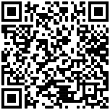
Please Take Our Survey
Scan Here:

Slide 27
Thank You for Listening!
Questions?
wellbeing.mst.edu | wellbeing@mst.edu | 204 Norwood Hall | (573).341.4211
studenthealth.mst.edu | mstshs@mst.edu | Student Health Complex | (573).341.4284

